Slide 1



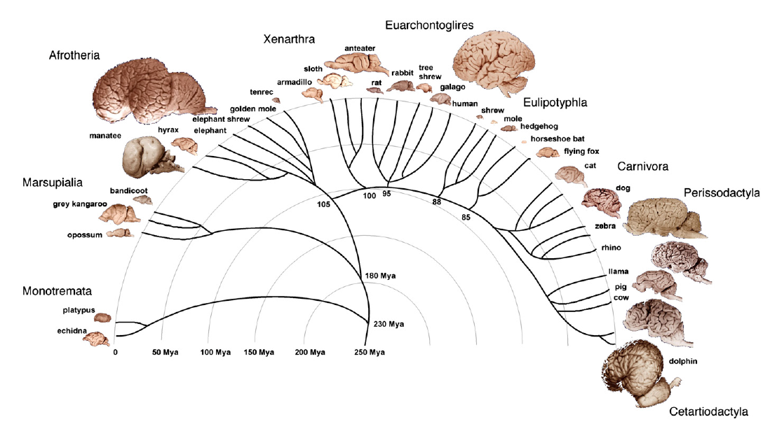
Lecture 12 More About Regression

Slide 2
Lecture 12: More About Regression
Interpreting summaries from “regression for description”
Interpreting standard errors from “inference for regression”
Checking assumptions for Inference

Slide 3
Lecture 12: More About Regression
Interpreting summaries from “regression for description”
Interpreting standard errors from “inference for regression”
Checking assumptions for Inference

Slide 4
Regression is most reasonable for “nicely behaved” data
One cluster
Linear
Constant spread

Slide 5
Regression is most reasonable for “nicely behaved” data
One cluster
Linear
Constant spread
Multiple clusters can lead to counter-intuitive results (Simpson’s paradox)

Slide 6

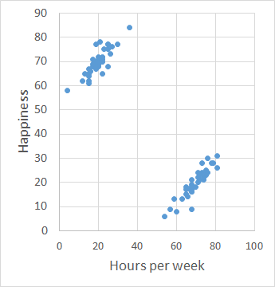

1991 UC Berkeley study:
r(hours of study, happiness) = –0.90
r = 0.84
r = 0.92

Slide 7
1991 UC Berkeley study:
r(hours of study, happiness) = –0.90
Always start by plotting your data!
If data have multiple clusters, it may make sense to analyze each cluster separately
r = 0.84
r = 0.92

Slide 8
Regression is most reasonable for “nicely behaved” data
One cluster
Linear
Constant spread

Slide 9
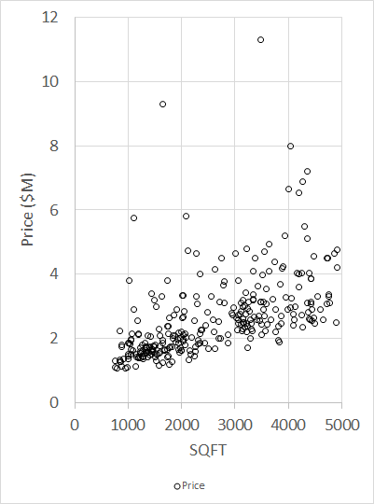
Regression is most reasonable for “nicely behaved” data
One cluster
Linear
Constant spread
Data for 286 houses in MB sold between 11/2/2016 and 11/1/2017

Slide 10
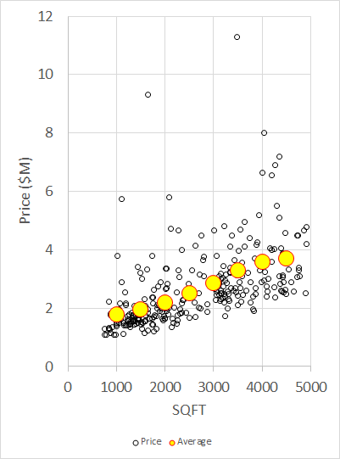
Regression is most reasonable for “nicely behaved” data
One cluster
Linear
Constant spread
Imagine dividing the data into vertical strips
Within each strip, compute average Y
“Linear” ⬄
“average Y = b₀ + b₁ X”
Data for 286 houses in MB sold between 11/2/2016 and 11/1/2017

Slide 11
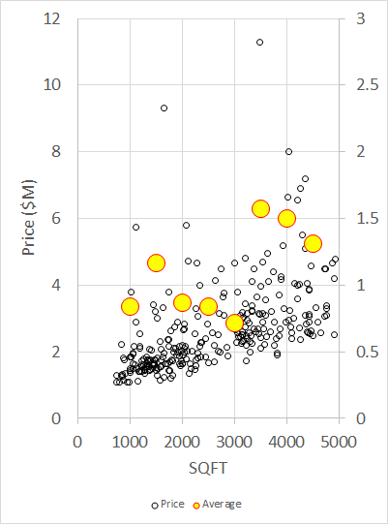
Regression is most reasonable for “nicely behaved” data
One cluster
Linear
Constant spread
Imagine dividing the data into vertical strips
Within each strip, compute SD of Y
Are the SD’s (more or less) the same?
Data for 286 houses in MB sold between 11/2/2016 and 11/1/2017

Slide 12
Regression is most reasonable for “nicely behaved” data
One cluster
Linear
Constant spread
If data are “nicely behaved”, then summary statistics can be useful
Data for 286 houses in MB sold between 11/2/2016 and 11/1/2017

Slide 13

Summary statistics for description:
r b₀ b₁
$\hat{y}$ e
rmse / SE_{Y|X}
Data for 286 houses in MB sold between 11/2/2016 and 11/1/2017

Slide 14
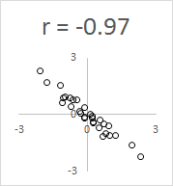
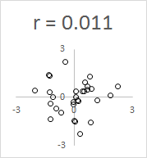
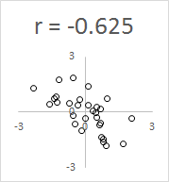
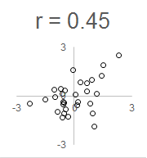
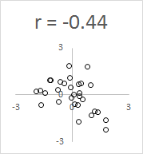
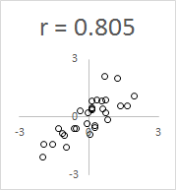
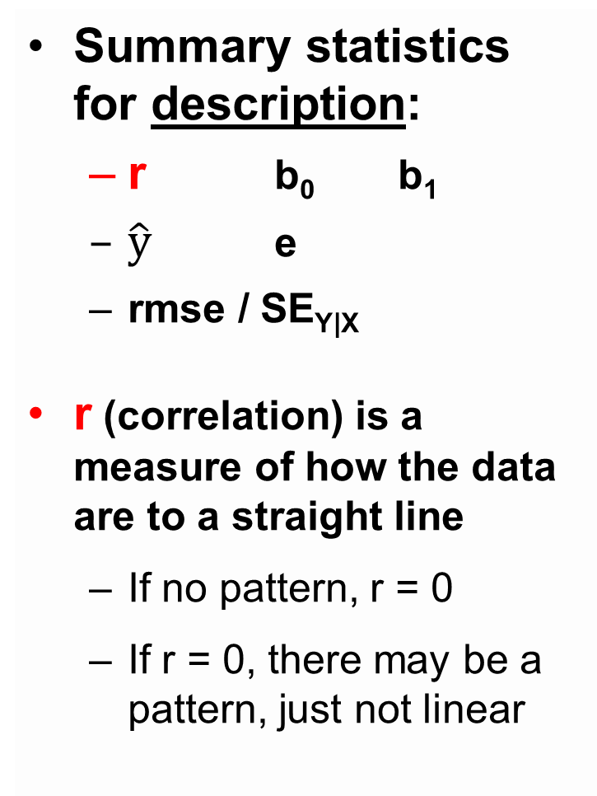
Summary statistics for description:
r b₀ b₁
$\hat{y}$ e
rmse / SE_{Y|X}
r (correlation) is a measure of how the data are to a straight line
If no pattern, r = 0
If r = 0, there may be a pattern, just not linear

Slide 15
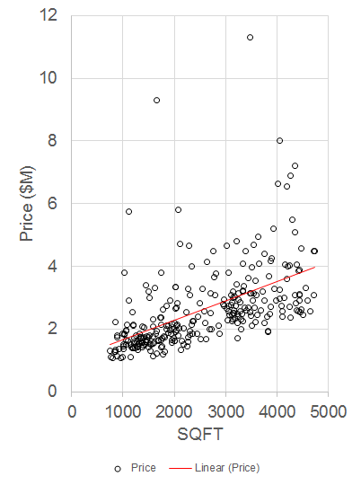
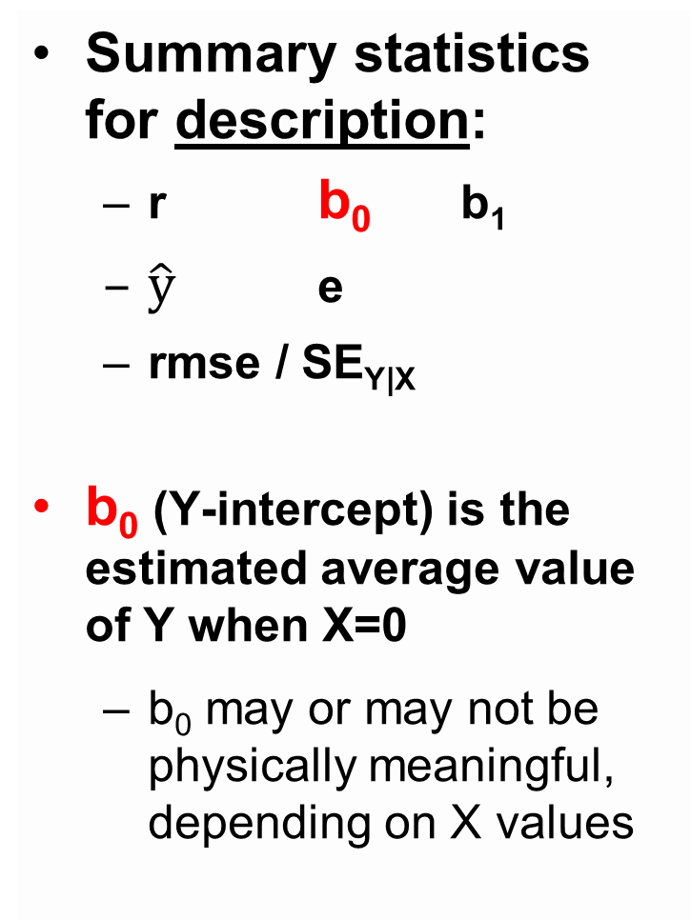
Summary statistics for description:
r b₀ b₁
$\hat{y}$ e
rmse / SE_{Y|X}
b₀ (Y-intercept) is the estimated average value of Y when X=0
b₀ may or may not be physically meaningful, depending on X values
b₀ = 1.06
Data for 286 houses in MB sold between 11/2/2016 and 11/1/2017

Slide 16
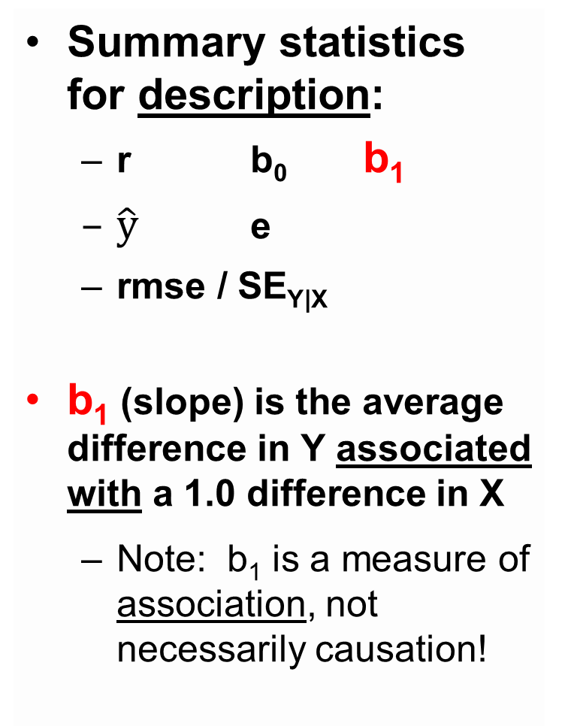
Summary statistics for description:
r b₀ b₁
$\hat{y}$ e
rmse / SE_{Y|X}
b₁ (slope) is the average difference in Y associated with a 1.0 difference in X
Note: b₁ is a measure of association, not necessarily causation!
b₁ = 0.000614 diff. in Y
1.0 diff in X
Data for 286 houses in MB sold between 11/2/2016 and 11/1/2017

Slide 17
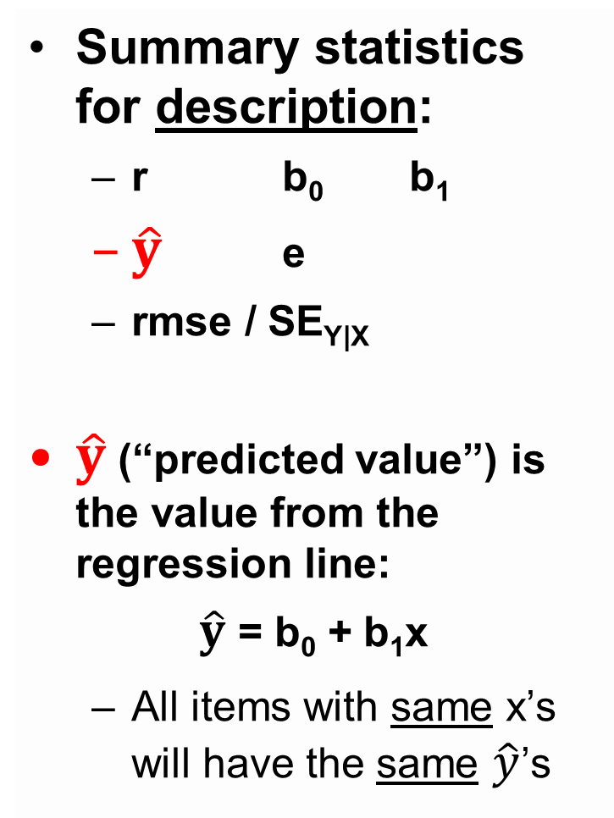

Summary statistics for description:
r b₀ b₁
$\hat{y}$ e
rmse / SE_{Y|X}
$\hat{y}$ (“predicted value”) is the value from the regression line:
$\hat{y}$ = b₀ + b₁x
All items with same x’s will have the same $\hat{y}$’s
$\hat{y}$ (regression line)
Data for 286 houses in MB sold between 11/2/2016 and 11/1/2017

Slide 18
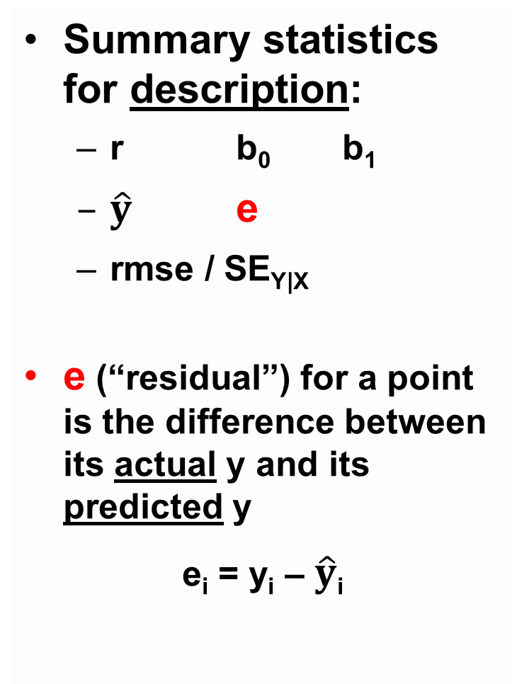
Summary statistics for description:
r b₀ b₁
$\hat{y}$ e
rmse / SE_{Y|X}
e (“residual”) for a point is the difference between its actual y and its predicted y
e_{i} = y_{i} – $\hat{y}$_{i}
large positive e
negative e
Data for 286 houses in MB sold between 11/2/2016 and 11/1/2017

Slide 19
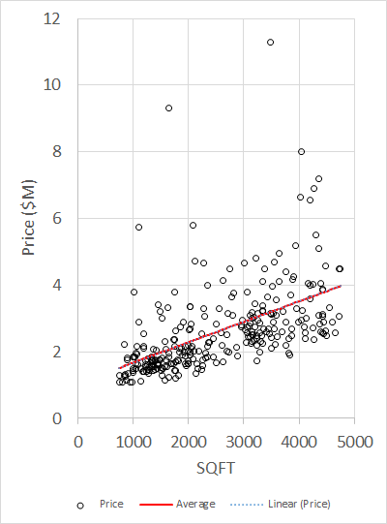
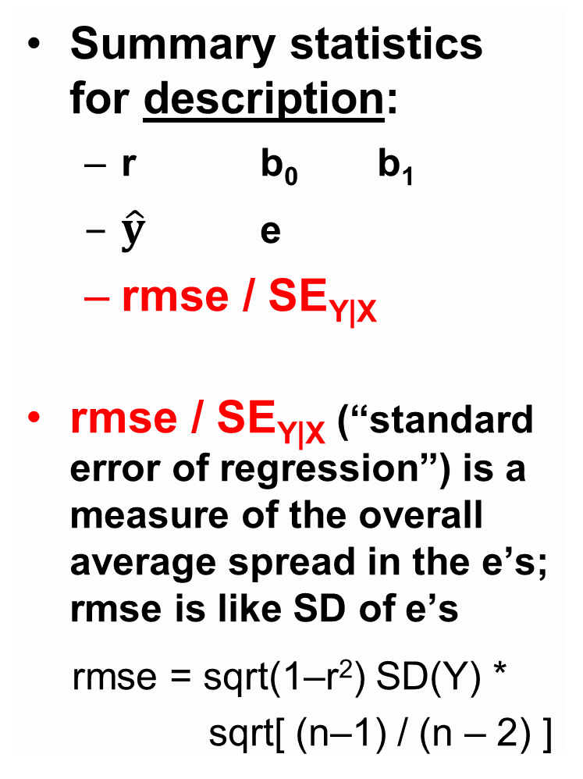
Summary statistics for description:
r b₀ b₁
$\hat{y}$ e
rmse / SE_{Y|X}
rmse / SE_{Y|X} (“standard error of regression”) is a measure of the overall average spread in the e’s; rmse is like SD of e’s
rmse = sqrt(1–r²) SD(Y) *
sqrt[ (n–1) / (n – 2) ]
+ 1 SE_{Y|X}
Data for 286 houses in MB sold between 11/2/2016 and 11/1/2017

Slide 20
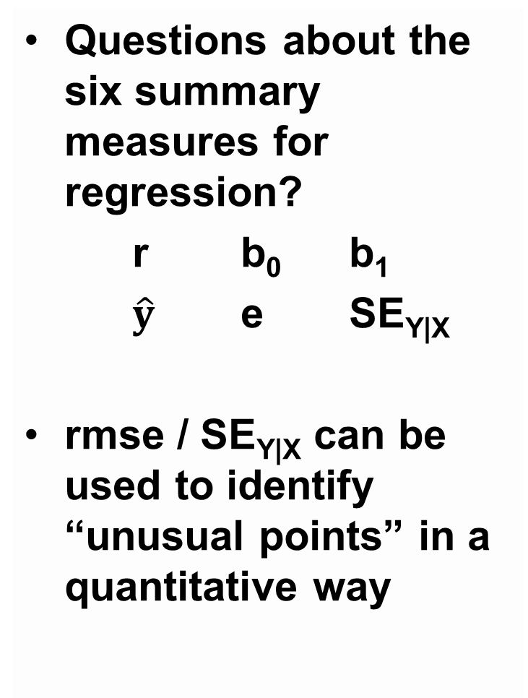
Questions about the six summary measures for regression?
r b₀ b₁
$\hat{y}$ e SE_{Y|X}
rmse / SE_{Y|X} can be used to identify “unusual points” in a quantitative way
+ 1 SE_{Y|X}
Data for 286 houses in MB sold between 11/2/2016 and 11/1/2017

Slide 21
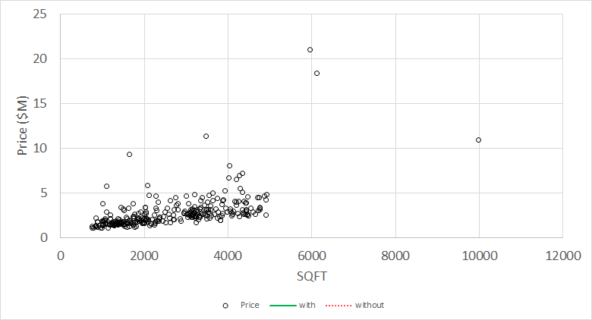
Selling price for 296 houses in MB:

Slide 22
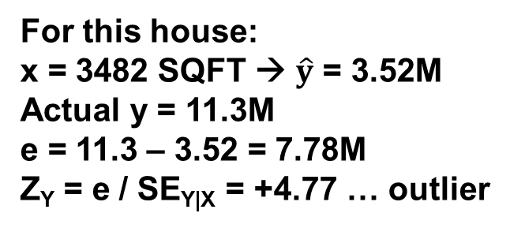
Outliers are points that are “unusual” in the Y direction
Rule of thumb: outlier ⬄ | e_{i} | / SE_{Y|X} > 2
For this house:
x = 3482 SQFT → $\hat{y}$ = 3.52M
Actual y = 11.3M
e = 11.3 – 3.52 = 7.78M
Z_{Y} = e / SE_{Y|X} = +4.77 … outlier

Slide 23
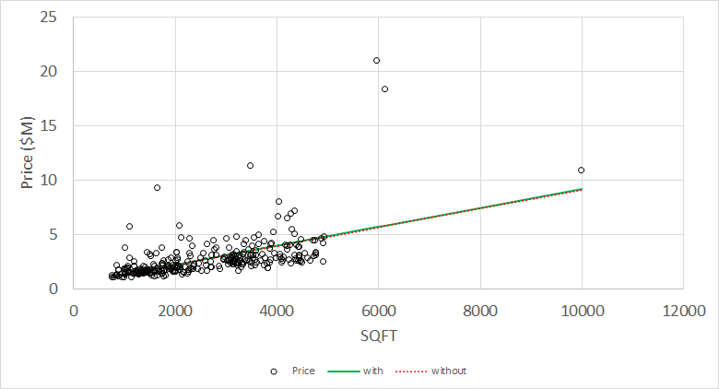
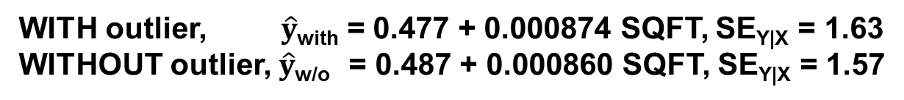
Outliers increase SE_{Y|X} but might not affect the regression line much, if the point is near the “middle” of the plot
WITH outlier, $\hat{y}$_{with} = 0.477 + 0.000874 SQFT, SE_{Y|X} = 1.63
WITHOUT outlier, $\hat{y}$_{w/o} = 0.487 + 0.000860 SQFT, SE_{Y|X} = 1.57
Similar predicted values … at SQFT = 10,000, $9.22M v. $9.09M

Slide 24
Leverage points are points that are “unusual” in the X direction
Rule of thumb: lev. ⬄ | (x_{i}–) / SD(X) | > 2
Avg X = 2638 SQFT
SD(X) = 1269 SQFT
9991 SQFT → Z_{X} = 5.8 … leverage point

Slide 25
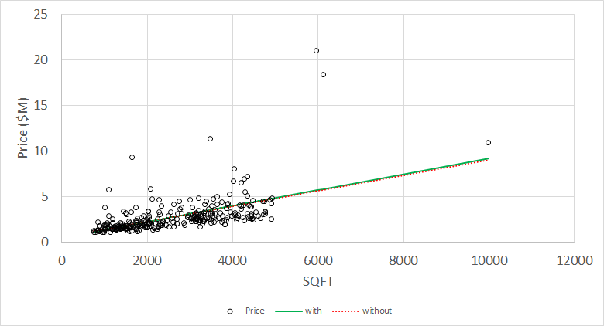
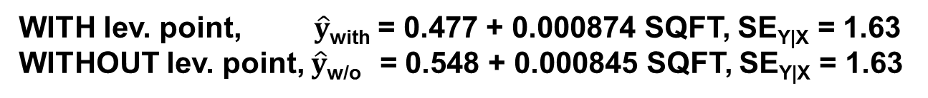
Leverage points might not affect the regression line, if the point is “in line” with the rest of the data
WITH lev. point, $\hat{y}$_{with} = 0.477 + 0.000874 SQFT, SE_{Y|X} = 1.63
WITHOUT lev. point, $\hat{y}$_{w/o} = 0.548 + 0.000845 SQFT, SE_{Y|X} = 1.63
Similar predicted values … at SQFT = 10,000, $9.22M v. $9.00M

Slide 26
Influence points are points that affect the regression line depending on whether they are included or not

Slide 27
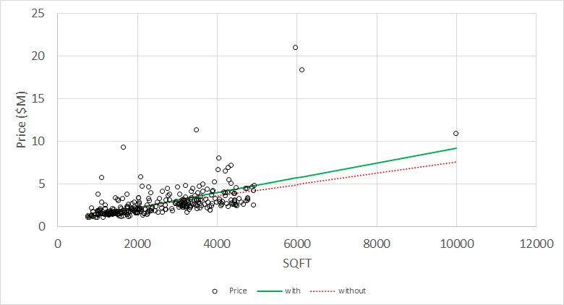
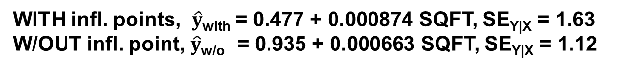
Influence points are typically both outliers and leverage points
More formal criteria exist, e.g. Cook’s D
WITH infl. points, $\hat{y}$_{with} = 0.477 + 0.000874 SQFT, SE_{Y|X} = 1.63
W/OUT infl. point, $\hat{y}$_{w/o} = 0.935 + 0.000663 SQFT, SE_{Y|X} = 1.12
Predicted value at SQFT = 10,000 is $9.22M or 7.56M

Slide 28
Real-world advice about dealing with “unusual points”, esp. influential points
Investigate them … is there a reason?
Influential
Outlier but not leverage
Leverage but not outlier

Slide 29
Real-world advice about dealing with “unusual points”, esp. influential points
Investigate them … is there a reason?
Run regressions both with and without the points … does it make a difference?
Decide whether to include or exclude points, document your reasoning, and then perform regression … and then do the other regression and put the results in an Appendix
Influential
Outlier but not leverage
Leverage but not outlier

Slide 30
The assumptions and results for “inference for regression” can be expressed graphically as well

Slide 31
Lecture 12: More About Regression
Interpreting summaries from “regression for description”
Interpreting standard errors from “inference for regression”
Checking assumptions for Inference

Slide 32
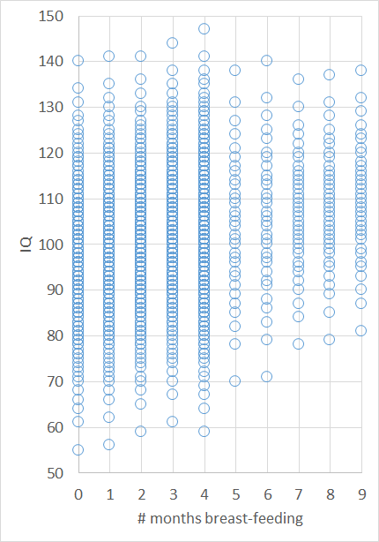
Assumptions for inference for regression:
There is a population

Slide 33
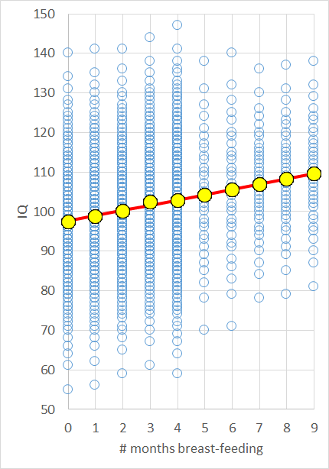
Assumptions for inference for regression:
There is a population
In the population, the relationship is linear
Yellow dots = average IQ for subgroup (_{i})
Red line =
β₀ + β₁x

Slide 34
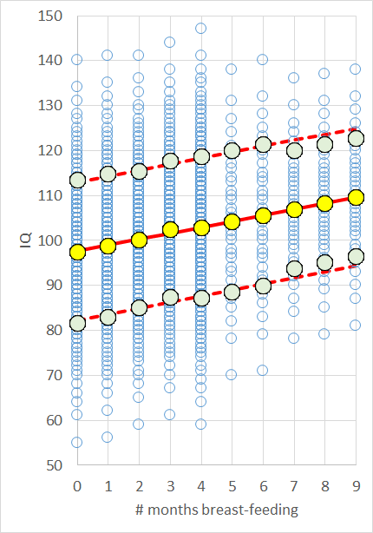
Assumptions for inference for regression:
There is a population
In the population, the relationship is linear
SD of points above and below the line is the same for all x
Green dots =
_{i} +1 (SD_{i})
Red dashed lines =
(β₀ + β₁x) + rmse

Slide 35
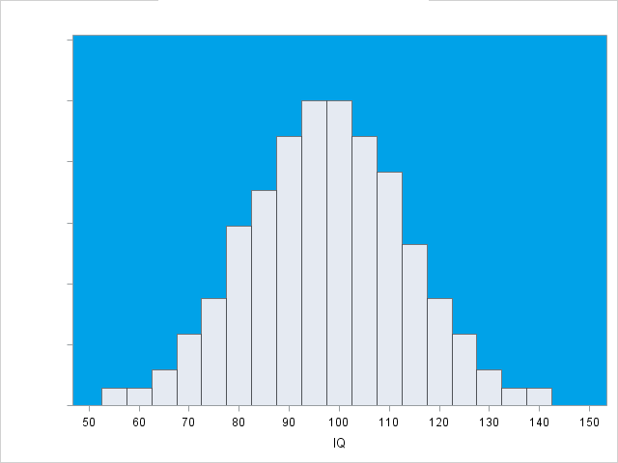
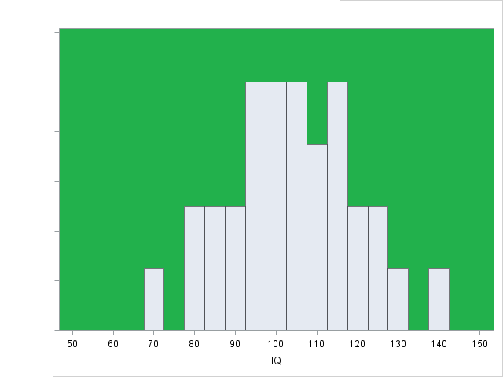
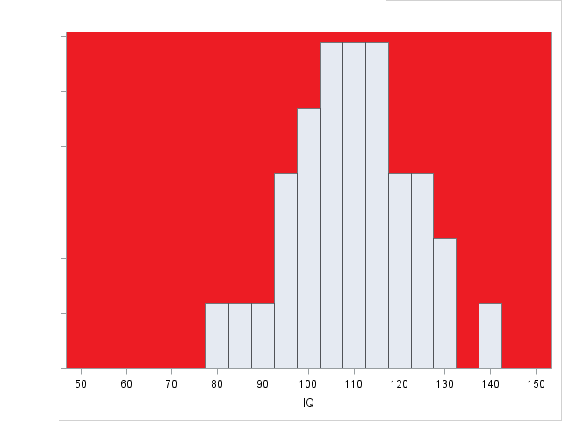
Assumptions for inference for regression:
There is a population
In the population, the relationship is linear
SD of points above and below the line is the same for all x
Points are normally distributed around the (population) line

Slide 36
Assumptions for inference for regression:
Linearity
Y_{i} = β₀ + β₁X + ε_{i}
E(ε_{i}) = 0
Homoscedasticity
SE(ε_{i}) = σ for all x
Independence
ε_{i}’s are independent
Normality
ε_{i}’s have normal dist.
Questions about the assumptions for inference for regression?

Slide 37
If the assumptions are true, certain formulas apply:
Recall: SE_{Y|X} = SD(Y)*sqrt(1–r²)*sqrt[ (n–2)/(n–1) ]
SE(indiv Y)=SE_{Y|X}*sqrt{1+(1/n)+(x–)²/[(n–1)SD(X)²]}
SE(b₀+b₁x) = SE_{Y|X}*sqrt{(1/n)+(x–)²/[(n–1)SD(X)²]}
SE(b₀) = SE_{Y|X}*sqrt{(1/n) + ²/[(n–1)SD(X)²]}
SE(b₁) = SE_{Y|X} / sqrt[(n–1)SD(X)]
T = b₁ / SE(b₁) = [r / sqrt(1–r²)] * sqrt(n–2)
For inference for simple regression, use T_{n–2}

Slide 38
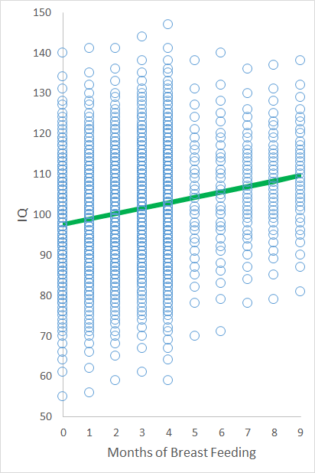
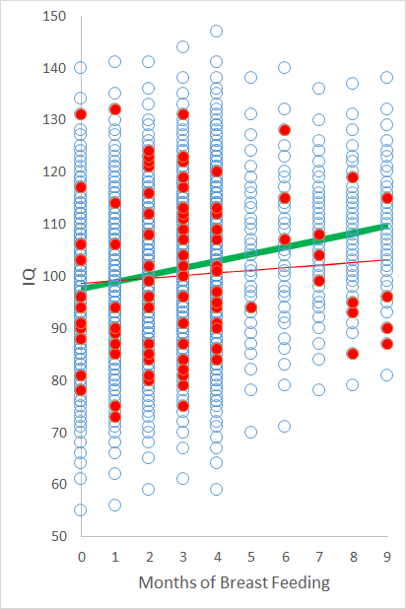
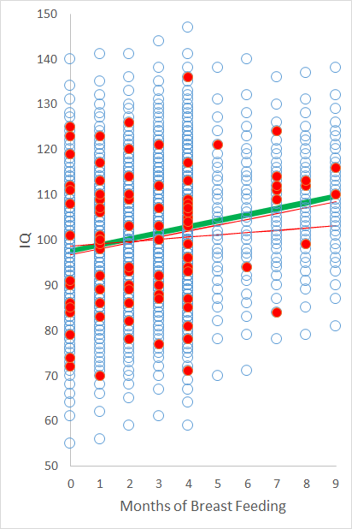
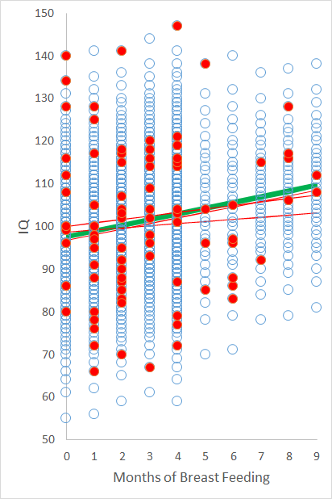
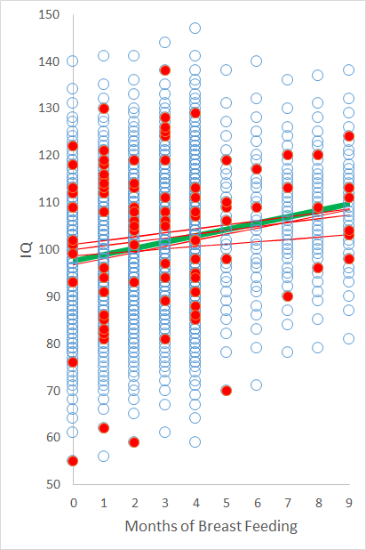
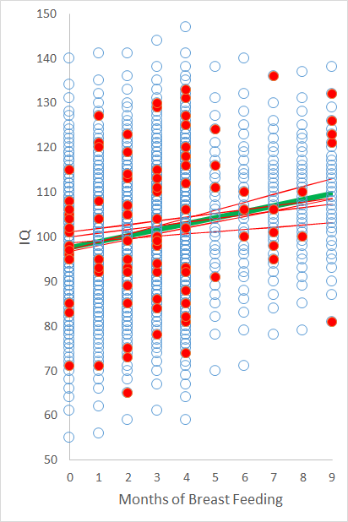
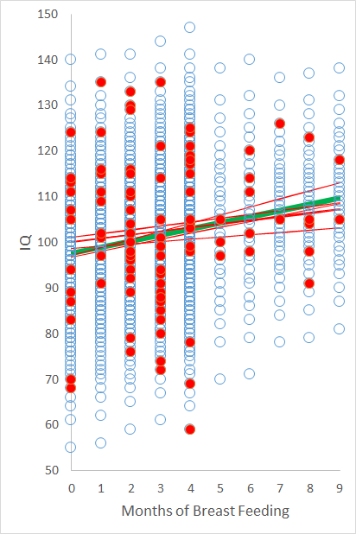
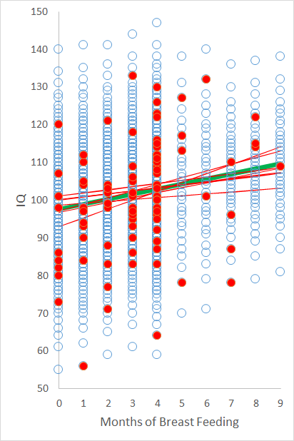
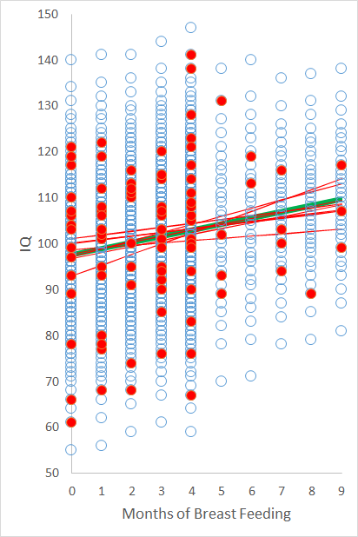
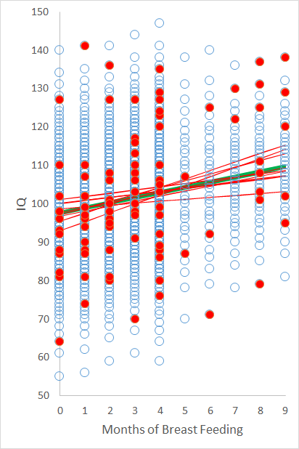
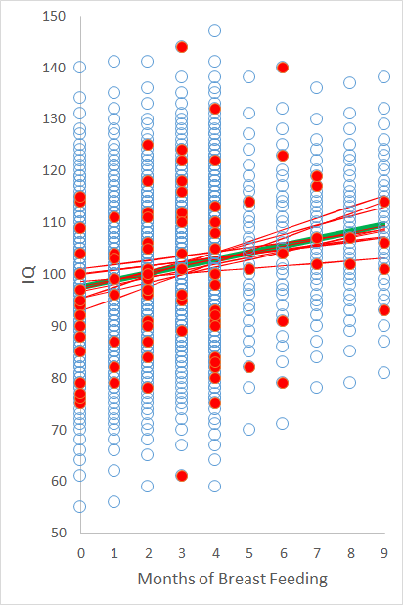
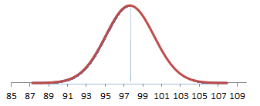
Different random samples lead to different sample regression lines
SE(b₀) is the spread among the possible sample intercepts
Distribution of possible b₀’s (n=95)
β₀
β₀ + SE(b₀)

Slide 39
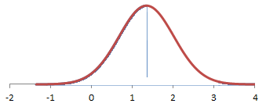
Different random samples lead to different sample regression lines
SE(b₁) is the spread among the possible sample slopes (“tilts”)
Distribution of possible b₁’s (n=95)
β₁
β₁ + SE(b₁)

Slide 40
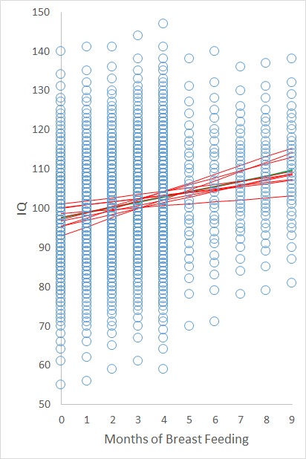

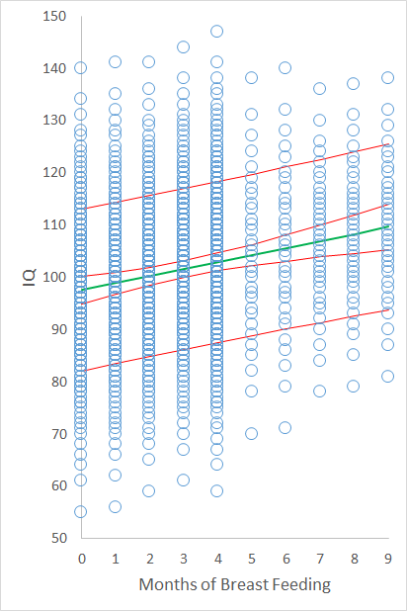
Different random samples lead to different sample regression lines
SE(b0+b₁x) is the uncertainty for an entire regression line at once
SE(indiv Y) is the variation among individual values around the population regression line
+ 1 SE(b₀+b₁x)
+ 1 SE(indiv Y)

Slide 41
Questions about the four SE’s?
SE(b₀)
SE(b₁)
SE(b₀ + b₁x)
SE(indiv Y at X)
If the assumptions are correct, the formulas apply
How can we tell if assumptions are correct?
+ 1 SE(b₀+b₁x)
+ 1 SE(indiv Y)

Slide 42
Lecture 12: Graphical Interpretation of Regression
Interpreting summaries from “regression for description”
Interpreting standard errors from “inference for regression”
Checking assumptions for Inference

Slide 43
Assumptions for inference for regression
Linearity
Y_{i} = β₀ + β₁X + ε_{i}
E(ε_{i}) = 0
Homoscedasticity
SE(ε_{i}) = σ for all x
Independence
ε_{i}’s are independent
Normality
ε_{i}’s have normal dist.

Slide 44

Assumptions for inference for regression
Linearity
Y_{i} = β₀ + β₁X + ε_{i}
E(ε_{i}) = 0
Homoscedasticity
SE(ε_{i}) = σ for all x
Independence
ε_{i}’s are independent
Normality
ε_{i}’s have normal dist.
One direct way to check: plot the data
Divide the data into vertical strips
Compute average and SD within each vertical strip
A somewhat better way: residual plots
Perform regression, get $\hat{y}$ and e
Plot e versus $\hat{y}$

Slide 45

http://www.mkomo.com/cost-per-gigabyte
Residual plots make it easier to see deviations from linearity
log₁₀($ for 1 GB of storage), 1985 – 2009:
Relationship is close to linear
(r = –0.99)
Pred. log₁₀($) = 566.88 – 0.283(Year)
Predicted $/GB
Date Predicted
3/8/2011 $0.0125
3/19/2012 $0.0064
3/17/2013 $0.0033
3/4/2014 $0.0018
$1,000,000
100,000
10,000
1,000
100
10
1
0.10
0.01

Slide 46

http://www.mkomo.com/cost-per-gigabyte
Residual plots make it easier to see deviations from linearity
Now construct residual plot:
Perform regression
Get predicted values, residuals
Plot residuals v. predicted values
$1,000,000
100,000
10,000
1,000
100
10
1
0.10
0.01
Most recent years (lowest predicted prices)

Slide 47


http://www.mkomo.com/cost-per-gigabyte
Residual plots make it easier to see deviations from linearity
Residual plots make it easier to see deviation from linearity
If you knew to look, you can see it
Actual prices have not fallen as quickly as linear model would have predicted
Predicted $/GB
Date Predicted Actual
3/8/2011 $0.0125 $0.0467
3/19/2012 $0.0064 $0.0475
3/17/2013 $0.0033 $0.0533
3/4/2014 $0.0018 $0.0350
$1,000,000
100,000
10,000
1,000
100
10
1
0.10
0.01

Slide 48


Residual plots can also make it see / quantify outliers
Data for 293 houses in Manhattan Beach
Original data
Residual plot … easier to see SE_{Y|X} ~ 1, that two houses were 7M and 8M above predicted

Slide 49


Excel can provide the data to construct a residual plot
Perform regression
Data → Data Analysis
→ Regression
For options, click
Residuals,
Residual Plots, and
Normal Prob. Plots

Slide 50

Excel’s output
Typical output (3 sections):

Slide 51
Excel’s output
Typical output (3 sections):
1. Coefficients and SE’s (and T)

Slide 52
Excel’s output
Typical output (3 sections):
2. Correlation, R², “adjusted R²”, SE_{Y|X}, n
adjusted R² = 1 – (SE_{Y|X} / SD(Y))² ... will be more important later

Slide 53
Excel’s output
Typical output (3 sections):
3. “ANOVA”
SS_{total} = (n–1)SD(Y)²
SS_{regression} = R² SS_{total}

Slide 54
Excel’s output
(Questions so far about “typical output” from Excel?)

Slide 55
Excel’s output
By checking “residuals” and “residual plot”, Excel will provide a list of predicted values and residuals

Slide 56



The columns from Excel can be used to create a residual plot
The “residual plot” created by Excel plots residual versus X, which is not quite the same
Mathematically less optimal, but maybe easier to understand
Residual plot
“Residual plot” from Excel

Slide 57

Summary:
Residual plots show e v. $\hat{y}$
Resid. plots make it easier to see nonlinearity, heteroscedasticity
Excel can be helpful
Questions about resid. plots?
Residual plot
“Residual plot” from Excel

Slide 58
Assumptions for inference for regression
Linearity
Y_{i} = β₀ + β₁X + ε_{i}
E(ε_{i}) = 0
Homoscedasticity
SE(ε_{i}) = σ for all x
Independence
ε_{i}’s are independent
Normality
ε_{i}’s have normal dist.
Looking at residuals may provide a clue about the ε’s
If the residuals are normally distributed, then maybe the ε’s are normal, too
One way to look: histogram of e’s
Another plot to examine: Q-Q plot

Slide 59
In a Quantile-Quantile (Q-Q) plot, data are plotted against a theoretical distribution (e.g., normal distribution)
If the theoretical distribution is correct, the points on the Q-Q plot should fall on a straight line
(Why? A Q-Q plot shows what percent of the data fall below some value x (or be below some percentile p), versus what percent of data SHOULD fall below x if the theoretical distribution were true)

Slide 60




Residuals for IQ from breast-feeding
Resid. for log₁₀($/GB) from year

Slide 61
Residuals for IQ from breast-feeding
Resid. for log₁₀($/GB) from year
Excel can provide Q-Q plots to see if residuals follow a normal distribution (click “Normal Probability Plots”)
Not as easy to see the shape of the distribution, but easier to see deviation from normal distribution

Slide 62
Assumptions for inference for regression
Linearity
Y_{i} = β₀ + β₁X + ε_{i}
E(ε_{i}) = 0
Homoscedasticity
SE(ε_{i}) = σ for all x
Independence
ε_{i}’s are independent
Normality
ε_{i}’s have normal dist.
Plots can be a useful way to check assumptions
Check for linearity / homoscedasticity with plots of Y v. X and residual plots
Check for normality of residuals with histograms and Q-Q plots
Questions so far?

Slide 63
Assumptions for inference for regression
Linearity
Y_{i} = β₀ + β₁X + ε_{i}
E(ε_{i}) = 0
Homoscedasticity
SE(ε_{i}) = σ for all x
Independence
ε_{i}’s are independent
Normality
ε_{i}’s have normal dist.
Checking independence is more difficult
ε’s may be correlated because of hidden variables (e.g., “The Strand”)
If data are collected over time, plot residuals over time to see if there is “tracking”

Slide 64

Assumptions for inference for regression
Linearity
Y_{i} = β₀ + β₁X + ε_{i}
E(ε_{i}) = 0
Homoscedasticity
SE(ε_{i}) = σ for all x
Independence
ε_{i}’s are independent
Normality
ε_{i}’s have normal dist.
Reminder: if the assumptions are true, then certain conclusions follow
$\hat{y}$ = b₀ + b₁X, SE(b₀), SE(b₁), SE(b₀+b₁X), SE(indiv Y at X), T_{n–2}
If the assumptions aren’t true, regression can give incorrect results

Slide 65


Sometimes, data show a relationship that is monotonic but not linear, like exponential growth / decay …
Other times, data may look somewhat linear but have lots of “small” values and a few “very big” values

Slide 66
For data that show exponential growth / decay models, a logarithmic transformation may be useful
Example: use X → ln(Y) instead of X → Y
Logarithmic transformations can sometimes the data more linear and make it easier to see any patterns in the bulk of the data (to prevent the plot from being dominated by just a few large values)

Slide 67
Brain and body mass data for 62 species of mammals:
Species | body | brain | Species | body | brain | Species | body | brain
African elephant | 6654 | 5712 | Goat | 27.66 | 115 | Patas monkey | 10 | 115
African giant pouched rat | 1 | 6.6 | Golden hamster | 0.12 | 1 | Phanlanger | 1.62 | 11.4
Arctic Fox | 3.385 | 44.5 | Gorilla | 207 | 406 | Pig | 192 | 180
Arctic ground squirrel | 0.92 | 5.7 | Gray seal | 85 | 325 | Rabbit | 2.5 | 12.1
Asian elephant | 2547 | 4603 | Gray wolf | 36.33 | 119.5 | Raccoon | 4.288 | 39.2
Baboon | 10.55 | 179.5 | Ground squirrel | 0.101 | 4 | Rat | 0.28 | 1.9
Big brown bat | 0.023 | 0.3 | Guinea pig | 1.04 | 5.5 | Red fox | 4.235 | 50.4
Brazilian tapir | 160 | 169 | Horse | 521 | 655 | Rhesus monkey | 6.8 | 179
Cat | 3.3 | 25.6 | Jaguar | 100 | 157 | Rock hyrax (Hetero. b) | 0.75 | 12.3
Chimpanzee | 52.16 | 440 | Kangaroo | 35 | 56 | Rock hyrax (Procavia hab) | 3.6 | 21
Chinchilla | 0.425 | 6.4 | Lesser short-tailed shrew | 0.005 | 0.14 | Roe deer | 14.83 | 98.2
Cow | 465 | 423 | Little brown bat | 0.01 | 0.25 | Sheep | 55.5 | 175
Desert hedgehog | 0.55 | 2.4 | Man | 62 | 1320 | Slow loris | 1.4 | 12.5
Donkey | 187.1 | 419 | Mole rat | 0.122 | 3 | Star nosed mole | 0.06 | 1
Eastern American mole | 0.075 | 1.2 | Mountain beaver | 1.35 | 8.1 | Tenrec | 0.9 | 2.6
Echidna | 3 | 25 | Mouse | 0.023 | 0.4 | Tree hyrax | 2 | 12.3
European hedgehog | 0.785 | 3.5 | Musk shrew | 0.048 | 0.33 | Tree shrew | 0.104 | 2.5
Galago | 0.2 | 5 | N. American opossum | 1.7 | 6.3 | Vervet | 4.19 | 58
Genet | 1.41 | 17.5 | Nine-banded armadillo | 3.5 | 10.8 | Water opossum | 3.5 | 3.9
Giant armadillo | 60 | 81 | Okapi | 250 | 490 | Yellow-bellied marmot | 4.05 | 17
Giraffe | 529 | 680 | Owl monkey | 0.48 | 15.5

Slide 68


Brain v. body weight
ln(brain) v. ln(body weight)

Slide 69
Logarithmic transformations can sometimes make it easier to see patterns in data (by making it so that the plot is not dominated by one or two large points)
Logarithmic transformations are also useful to examine / describe variation in percentage terms
Variation on a log scale is like percentage variability: ln(y) = x+δ ⬄ y = e^{x}(e^{δ})

Slide 70




SQFT and ln(SQFT) to predict PRICE and ln(PRICE) for MB homes:
Y = PRICE
Y = ln(PRICE)
X = SQFT
X = ln(SQFT)

Slide 71
When using logarithms, the slope basically describes percentage change
b₁ = 874 $ / SQFT → every add’l square foot is associated with $874 higher price
b₁ = $1,903,478 / % → 1% larger SQFT is associated with $1,903,478 higher price
Y = PRICE
b₁ = 0.000250 → every add’l SQFT is associated with 0.0250% higher price
b₁ = 0.607 % / % → 1% larger SQFT is associated with 0.607% higher price (“elasticity”)
Y = ln(PRICE)
X = SQFT
X = ln(SQFT)

Slide 72
Using ln(X) to predict ln(Y) is sometimes called a “power law” model
The slope b₁ in “ln(Y) = b₀ + b₁ ln(X)” is called the elasticity, “how small percentage changes in x are associated with small percentage changes in y”
Example: “a 1% larger square footage is associated with an 0.6% higher selling price”

Slide 73
A special case of the “power law” model is the learning curve model
Idea: more experience leads to lower costs / higher quality, but incremental improvements take more and more effort
Learning Curve Model (original):
ln(cost of n^{th} unit) = b₀ + b₁ ln(total n)
Note 1: use TOTAL (cumulative) n … this represents the “total learning” that has gone into the product
Note 2: 2^b₁ is the “learning curve factor”, which is the ratio of Y’s when the cumulative number of units has doubled; smaller learning curve factors mean faster improvement (faster reduction in cost) with experience

Slide 74
A company was interested in estimating its cost of future production
“Boxes” were sold in Year 1 for $400
The Company started producing “boxes” in year 2, for large profits
Year | Annual. Prod | Cost | Global sales (M) | Market Price
1 |  |  | 2.5 | $400
2 | 76,000 | $98 | 5.0 | $216
3 | 264,000 | $45 | 15.0 | $130
4 | 810,000 | $35 | 25.0 | $80
Total global market estimated to be 160M, with 40M per year thereafter

Slide 75
Based on these data, what is the estimated cost when the Company produces its 2 millionth unit?
Year | Annual. Prod | Cost | Global sales (M) | Market Price
1 |  |  | 2.5 | $400
2 | 76,000 | $98 | 5.0 | $216
3 | 264,000 | $45 | 15.0 | $130
4 | 810,000 | $35 | 25.0 | $80
Total global market estimated to be 160M, with 40M per year thereafter

Slide 76
For the learning curve, use ln(cumulative n) to predict ln(price)
Compute cumulative n
Compute ln(cumulative n) and ln(price)
Use ln(cumulative n) to predict ln(price)
Result: pred ln(cost) =8 .841–0.384 ln(cum n)
Year | Annual Prod | Price | Cum n | ln(cum n) | ln(price)
2 | 76,000 | 98 | 76,000 | 11.2385 | 4.5850
3 | 264,000 | 45 | 340,000 | 12.7367 | 3.8067
4 | 810,000 | 35 | 1,150,000 | 13.9553 | 3.5553

Slide 77

Predicted ln(cost) = 8.841–0.384 ln(cum n)
→ 2^{–0.3843} = 0.766, so Company has 76.6% learning curve
Does this model fit the data?
… yes (as best we can tell, based on three data points)
Year | Annual Prod | Price | Cum n | ln(cum n) | ln(price)
2 | 76,000 | 98 | 76,000 | 11.2385 | 4.5850
3 | 264,000 | 45 | 340,000 | 12.7367 | 3.8067
4 | 810,000 | 35 | 1,150,000 | 13.9553 | 3.5553

Slide 78
Predicted ln(cost) = 8.841–0.384 ln(cum n)
→ 2^{–0.3843} = 0.766, so Company has 76.6% learning curve
What is predicted cost of 2 millionth item?
n = 2 million → predicted ln(cost) = 3.2656 → predicted cost = $26.20
Year | Annual Prod | Price | Cum n | ln(cum n) | ln(price)
2 | 76,000 | 98 | 76,000 | 11.2385 | 4.5850
3 | 264,000 | 45 | 340,000 | 12.7367 | 3.8067
4 | 810,000 | 35 | 1,150,000 | 13.9553 | 3.5553

Slide 79
Summary:
Items cost $35 to make, but the 2 millionth item will cost $26
We could spend $7M to build a plant to increase production from 810K per year to 1.6M per year … should we?
Year | Annual. Prod | Cost | Global sales (M) | Market Price
1 |  |  | 2.5 | $400
2 | 76,000 | $98 | 5.0 | $216
3 | 264,000 | $45 | 15.0 | $130
4 | 810,000 | $35 | 25.0 | $80
Total global market estimated to be 160M, with 40M per year thereafter

Slide 80
Next Time
Lecture 13: Mathematical Models
Year | Annual. Prod | Cost | Global sales (M) | Market Price
1 |  |  | 2.5 | $400
2 | 76,000 | $98 | 5.0 | $216
3 | 264,000 | $45 | 15.0 | $130
4 | 810,000 | $35 | 25.0 | $80
Total global market estimated to be 160M, with 40M per year thereafter

Slide 83

 $\hat{p} \hat{y}$

